Slide 1
Team 1
Detecting Parkinson’s disease using Vocal Data from Patients
Submitted to: Dr. Amar Sabih
Abdulah Alhoothy: 40075668
Muhammad Haris: 40150933
Qamar Bani-Melhem: 40109566
Sourav Patne: 40137125
Yaoxin Li: 40092820

Slide 2
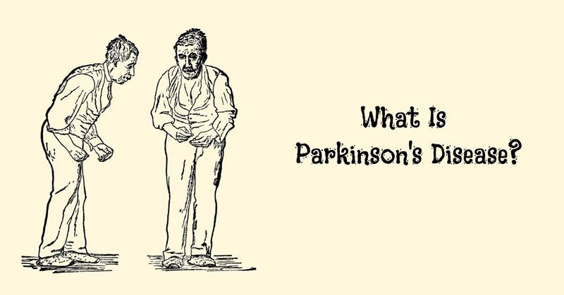

Slide 3
Problem description
We are using Vocal test results in our study, we use 10 out of 24 different vocal Phonation such as Jitter, Shimmer, Harmonics to noise ratio etc.
We minimize these 24 attributes using different statistical techniques to find out which of the attributes are most likely dependent on the final status of the patient, these techniques are going to be discussed in the next slides.
Assumptions and limitations
1. doctor’s diagnosis is assumed to be correct.
2. All the testing equipment are in the best working conditions and
3. Testing machines are properly calibrated as per prescribed guidelines.
1. The data used for analysis is limited.
2. The measuring equipment has limitations on measuring the values.
3. Limited access to the patient's medical history, therefore we can’t use any other information.

Slide 4
Data analysis
In our study, we have a Dataset of 195 records - we deal with each record as a patient- 147 of these records shows an indication of having a Parkinson disease; which they show 1 in their status.
There were 24 attributes, after using cross correlation we decided to study 10 out of 24 attributes. These are the attributes we studied: MDVP (FO), MDVP(FHI), MDVP(FLO), MDVP: shimmer, HNR, D2, Spread 1-2, RPDE and DFA.
Methodology
Cross correlation.
Reducing attributes.
Histogram.
Descriptive Statistical analysis
Stages.
Proportion hypothesis test.
Test normality.
Multiple linear regression.

Slide 5
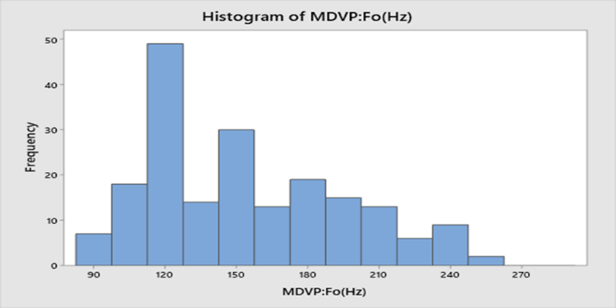
Statistical analysis
Histogram
We used histogram for analyzing all attributes of patients. We are going to discuss one attribute.
Shape: The distribution of MDVP: Fo (Hz) is unimodal it has one mode at a value of 120 about which the observations are concentrated. It is right-skewed, larger values at the right tail are greater than the left tail.
Outliers: No outliers exist.
Centre: The centre of distribution approximately 165.
Spread: The data of this attribute range from 85 to 255.

Slide 6
Descriptive Statistical analysis
Attributes | Mean | 95%Ci | Standard Error | Median | Standard Deviation | Variance | Mode
MDVP (FO) | 154.45 | 6.47 | 3.27 | 151.88 | 39.97 | 1597.76 | n/a
MDVP (FHI) | 193.81 | 13.39 | 6.78 | 179.14 | 82.73 | 6845.02 | n/a
MDVP (FLO) | 115.65 | 7.06 | 3.57 | 104.77 | 43.59 | 1899.99 | n/a
MDVP (Shimmer) | 0.03 | 0.00 | 0.00 | 0.02 | 0.02 | 0.00 | 0.02
HNR | 22.05 | 0.74 | 0.37 | 22.24 | 4.54 | 20.65 | n/a
RPDE | 0.50 | 0.02 | 0.01 | 0.50 | 0.10 | 0.01 | n/a
Spread 1 | -5.69 | 0.17 | 0.09 | -5.66 | 1.07 | 1.14 | n/a
Spread 2 | 0.23 | 0.01 | 0.01 | 0.23 | 0.09 | 0.01 | 0.21
DFA | 0.72 | 0.01 | 0.00 | 0.73 | 0.05 | 0.00 | n/a
D2 | 2.39 | 0.06 | 0.03 | 2.38 | 0.39 | 0.15 | n/a

Slide 7
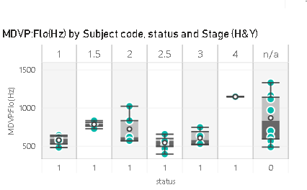
Stages comparing Stages of the disease
No distinction between patients with PD and those without for any of the 10 parameters
If there was a clear distinction between the measurement of any two different groups of any of the 10 parameters then that parameters would be a good reference for detecting Parkinson's.

Slide 8

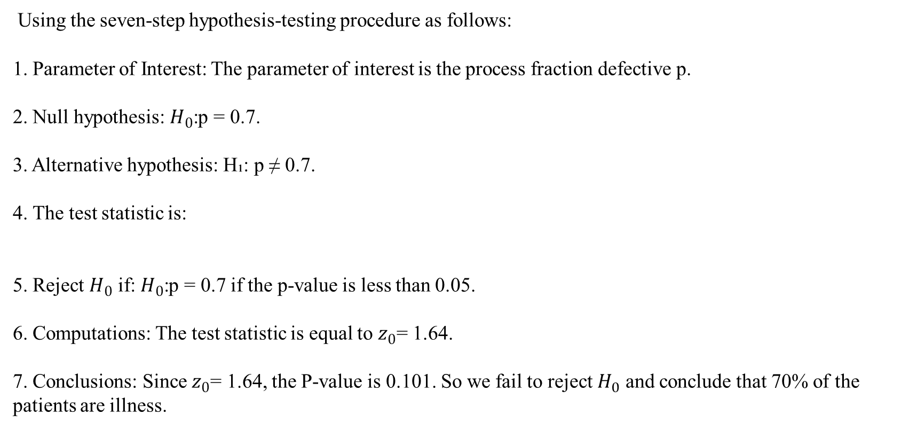
Hypothesis test
We used the Minitab to make the proportion hypothesis test on the status (0,1) attribute.
Using the seven-step hypothesis-testing procedure as follows:
1. Parameter of Interest: The parameter of interest is the process fraction defective p.
2. Null hypothesis: $H_{0}$:p = 0.7.
3. Alternative hypothesis: H₁: p ≠ 0.7.
4. The test statistic is:
5. Reject $H_{0}$ if: $H_{0}$:p = 0.7 if the p-value is less than 0.05.
6. Computations: The test statistic is equal to $z_{0}$= 1.64.
7. Conclusions: Since $z_{0}$= 1.64, the P-value is 0.101. So we fail to reject $H_{0}$ and conclude that 70% of the patients are illness.

Slide 9
Minitab results
Here, we are showing the Minitab results:
N | Event | Sample p | 95% CI for p
195 | 147 | 0.753846 | (0.693385, 0.814307)
Null hypothesis | H₀: p = 0.7 | Z-Value | P-Value
Alternative hypothesis | H₁: p ≠ 0.7 | 1.64 | 0.101

Slide 10
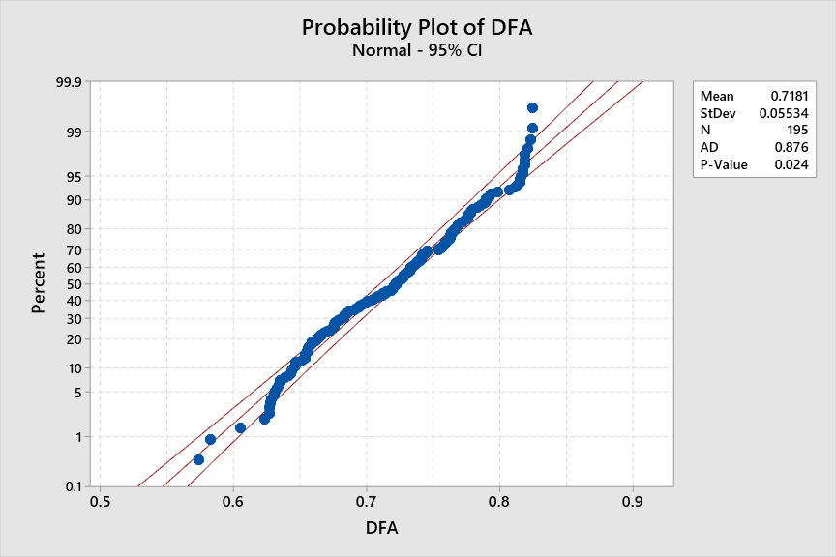
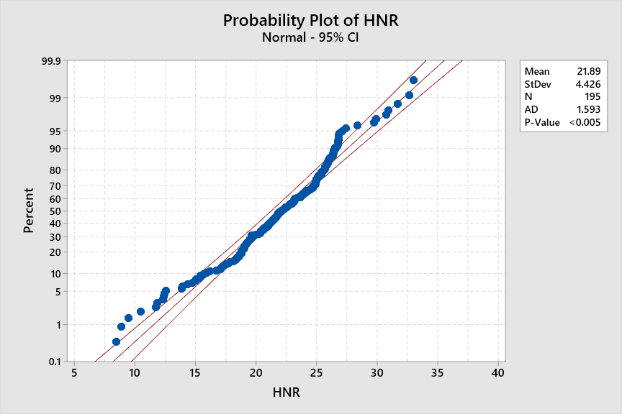
Normality Test
We test the normality using Minitab. To decide which attribute follow the normality we check the P-value. We have 6 attributes are not normally distributed (MDVP:Fo(Hz) - HNR- MDVP:Flo(Hz) - RPDE- MDVP:Fhi(Hz) - MDVP:Shimmer) and 4 attributes are normally distributed (Spread1 - Spread2 - D2 - DFA).

Slide 11
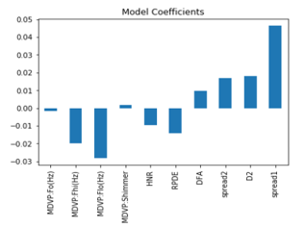
Multiple linear regression
We used python to find the coefficient of the attributes.
As seen from the graph, it seems that spread1 is the most important for predicting the status followed by MDVP: Flo(Hz) and so on, as shown in the below equation:
$$y = {−0.00157734x}_{1}−{0.0197791x}_{2}−{0.02834955x}_{3}+{0.00183221x}_{4}−{0.00973751x}_{5}−{0.01420971x}_{6}+{0.00981635x}_{7}+{0.01692955x}_{8}+{0.01816465x}_{9}+{0.04656127x}_{10}$$
Y: represents a range between (0,1) which indicates if the person has PD or not.
X: represents the values gotten from the voice records

Slide 12
Conclusion
In Conclusion, Through the use of dysphonia (voice) we present a method for distinguishing between individuals who are healthy and those that have Parkinson’s disease (PD).
1. Relationship between these reduced attributes is found out using linear Regression which can predict the status of the patient with 94.8% Accuracy.
2. Non-standard methods in combination with voice discriminators could be 94.8% capable of separating individuals with PD from healthy ones.

